Slide 1
Feasibility Study Public Private Partnership with the World Bank India.
Adriaan Vernooij, Wageningen Livestock Research
Peter Ravensbergen, Wageningen Food and Biobased Research
Wouter Verhey, Landbouwraad Delhi.

Slide 2
Feasibility Study Public Private Partnership with the World Bank India.
Background:
●”Food for All” partnership agreement (MoU) Netherlands/WBG
●Aim: To match cutting-edge Dutch technical expertise and private sector innovation with programs and investments by the WBG and IFC.
●Signed in November 2015.
●Request from Agricultural Counsellor for feasibility study in India.

Slide 3
Feasibility Study Public Private Partnership with the World Bank India.
Seed Money Project: Feasibility Study Public Private Partnership with the World Bank, India.
●Aim: To investigate the feasibility of collaboration with the WBG India for the Dutch Topsectors Agri & Food and Horticulture & Propagation Materials, and the options to implement the collaboration in a PPP set up.
●Two sectors: dairy and fresh foods (fruits and vegetables).
●Dairy: Wageningen Livestock Research
●Fresh Foods: Wageningen Food and Biobased Research.

Slide 4
Overview of activities
June: visit WLR to Punjab, Gujarat, Assam.
July and August: consultation private sector
August:
visit FBR New Delhi: meeting with representatives of Gov’t of Assam and Himachal Pradesh
Expression of Interest “Consultancy for International Consultancy Services for Cold Chain”
November:
meeting Fokke Fennema
Visit FBR Assam
December: submittal proposal Assam

Slide 5
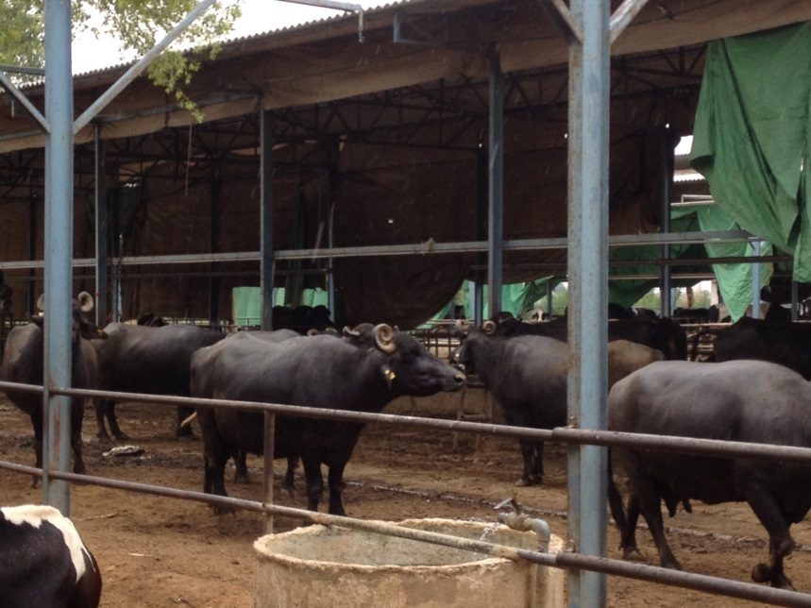
Feasibility Study Public Private Partnership with the World Bank India.
Dairy sector India:
●Largest milk producer, aim to double
production
●2012-2027National Dairy Plan
●1.4 B $ investments in NDP, 50 % WBG loan.
●Implemented by NDDB (National Dairy Development Board), umbrella all dairy cooperatives.
●Growing private investments in dairy sector: processing, production (medium and some large scale).
.

Slide 6
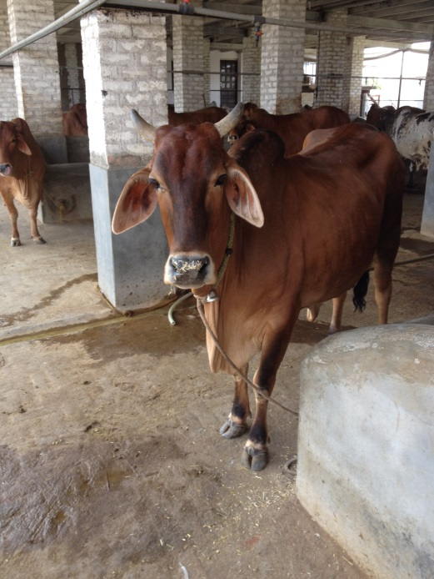
Feasibility Study Public Private Partnership with the World Bank India.
Dairy sector India:
●Two Dutch dairy consortia active in India: NAFTC Dairy Cluster, VHL RAAK project on dairy housing with
Baramati Agricultural College.
●NDP: focus on small scale farmers
●Cooperatives and newly emerging producer
companies do invest in large scale activities on
behalf of member (mechanization, breeding)
●Dutch dairy clusters to build up further contacts with NDDB and its cooperatives in most important dairy states.

Slide 7
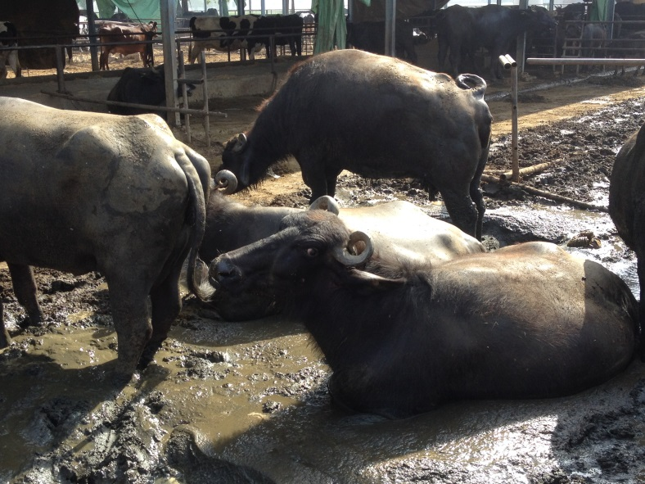
Feasibility Study Public Private Partnership with the World Bank India.
●Milk production in India: 95+ % smallholders (1-5 cows).
●Main entry point for dairy sector/WBG support is through cooperatives
●Cooperatives provide collective roles in dairy production improvement:
●Processing
●Fodder production and conservation
●Feed (concentrates) production
●Breeding services
●
●

Slide 8
Feasibility Study Public Private Partnership with the World Bank India.
New options: pigs in NE East India.
●WB SMART Program in preparation
●Development pig sector important element, technical assistance during implementation is option.
●Research contacts WLR with National Research Centre on Pigs, Guwahati, Assam. Intensive research necessary for preparation development of pig sector (genetic base, local feed base).
●Private (Indian) investor in slaughtering/processing, support ICCO for setting up breeding farm, new investment in feed production
●Interest from Dutch companies (breeding, feed)
●

Slide 9
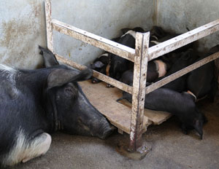
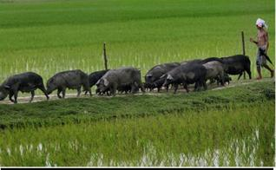
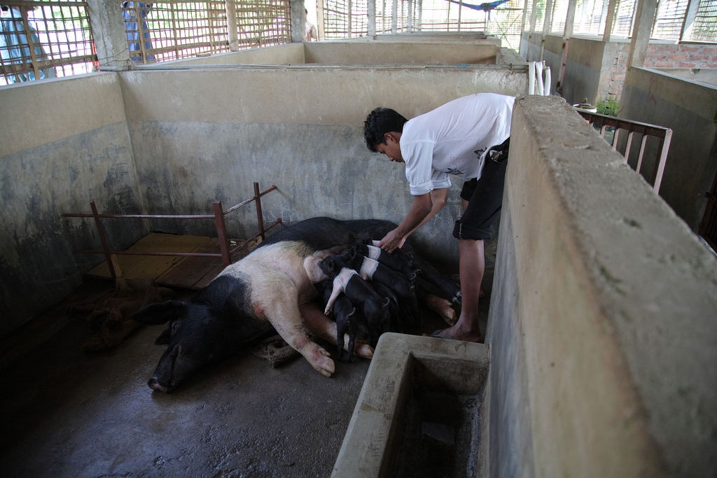
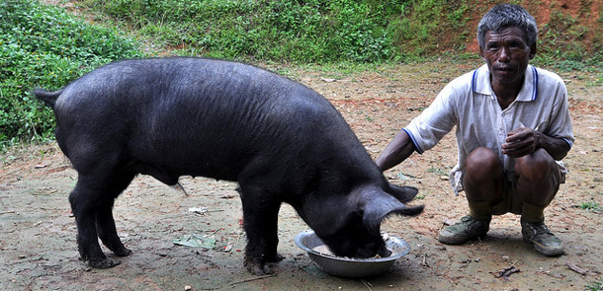
Feasibility Study Public Private Partnership with the World Bank India.

Slide 10
Fresh Fruits and vegetables: FBR.
India: 2nd largest producer fruits and vegetables.
Little export, due to poor quality
Lack of cold chain, storage and processing facilities
30-40 % losses post harvest

Slide 11
1st visit India Fresh Food: august 2016
Workshop with representatives Himachal Pradesh (HP) & Assam
Agreements:
WB program HP is ready. Presently consultancy calls in tender phase: Wageningen has submitted EoI and proposal;
WB Program Assam is being prepared: request for visit Wageningen FBR to Assam in Oct/Nov.

Slide 12
Assam
Assam is dependant on agriculture:
About 90% of state’s population lives in rural areas
Agriculture supports >75% of the population, providing employment to ≈50% of total workforce.
Small size farming: 85% is small, av. size 0.63 ha
The food processing sector is largely unorganized and operates on a small scale.
WB Assam Agribusiness & Rural Transformation project is to “increase value-added and improve resilience in the production and processing of selected agriculture commodities, focusing on small farmers and agro-entrepreneurs in targeted districts”.

Slide 13
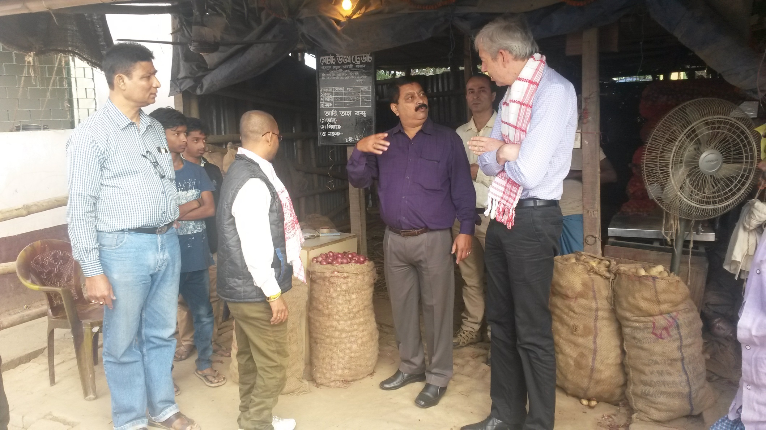
2nd visit Assam 7-8 November 2016 Guwahati Vegetables Wholesale market

Slide 14
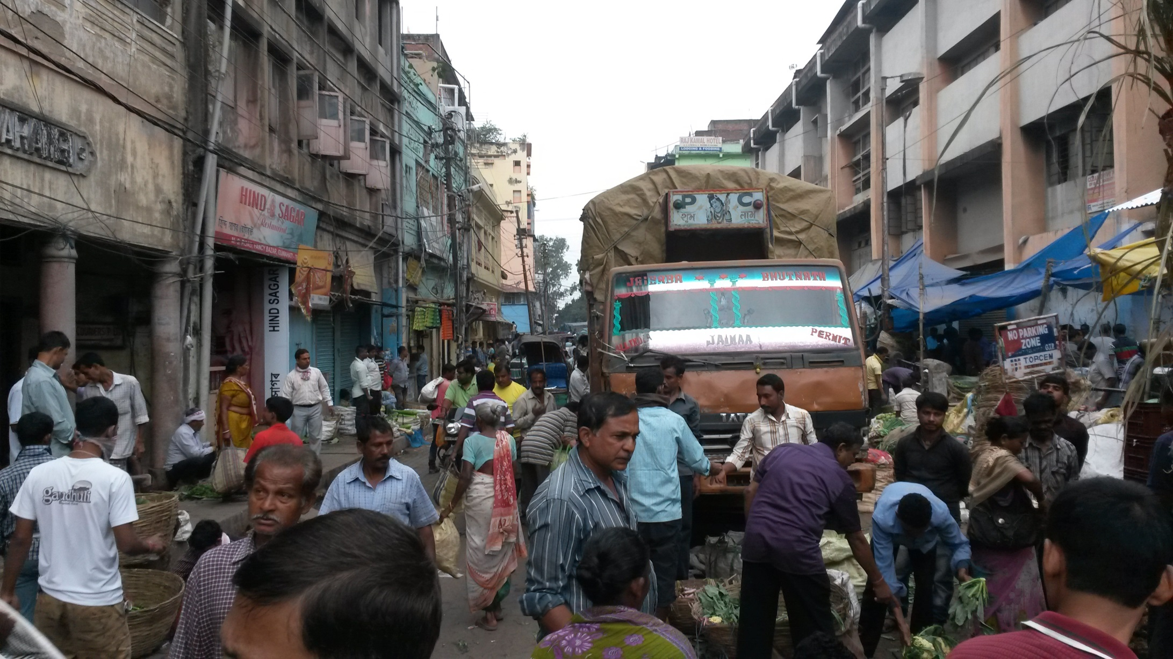
Guwahati Fruit Wholesale Market

Slide 15
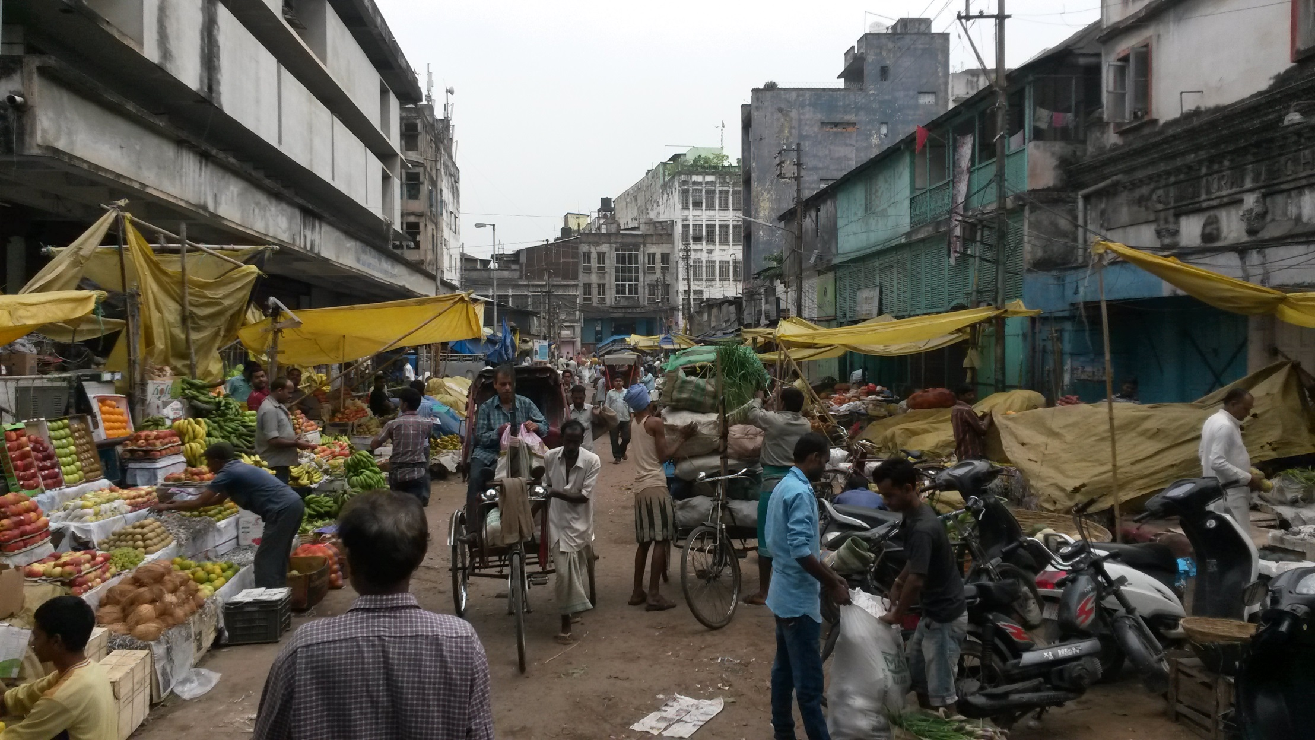
Guwahati, wholesale market fruits

Slide 16
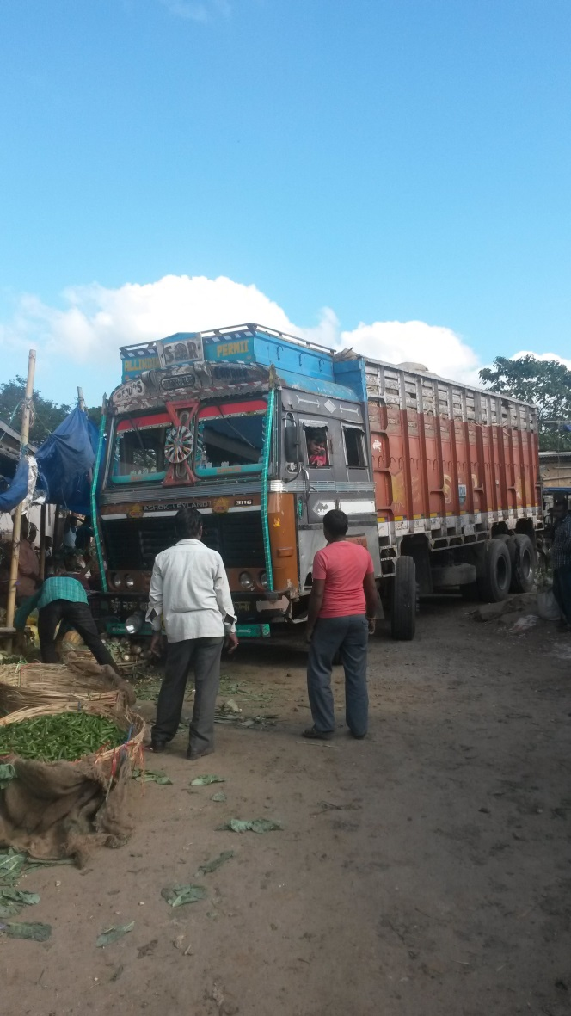
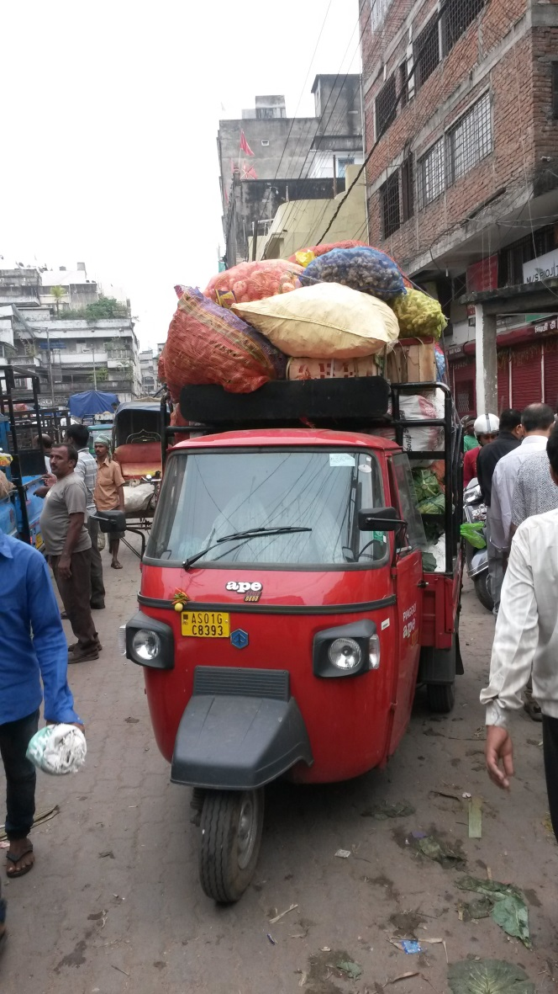
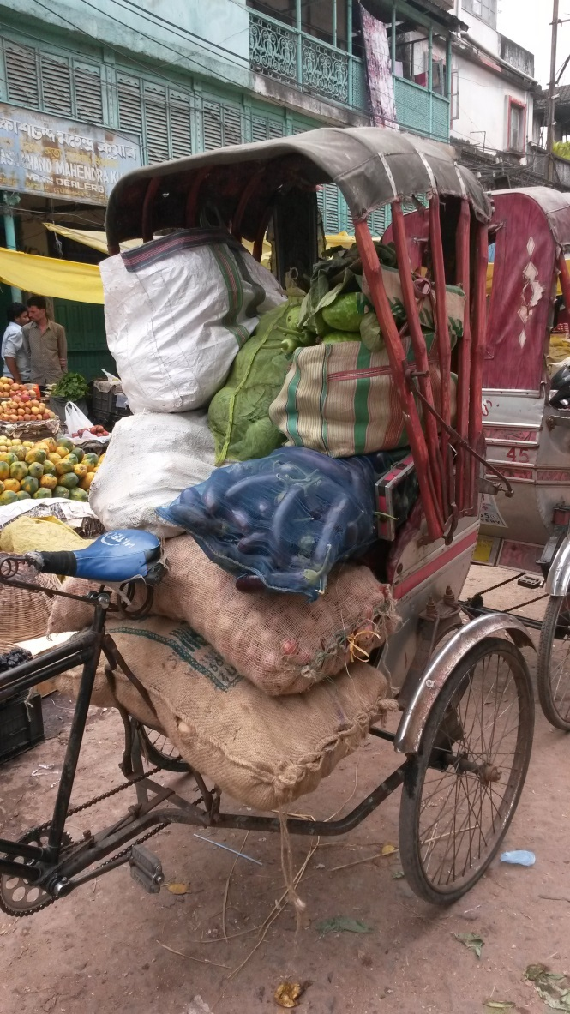
Agro-logistics

Slide 17
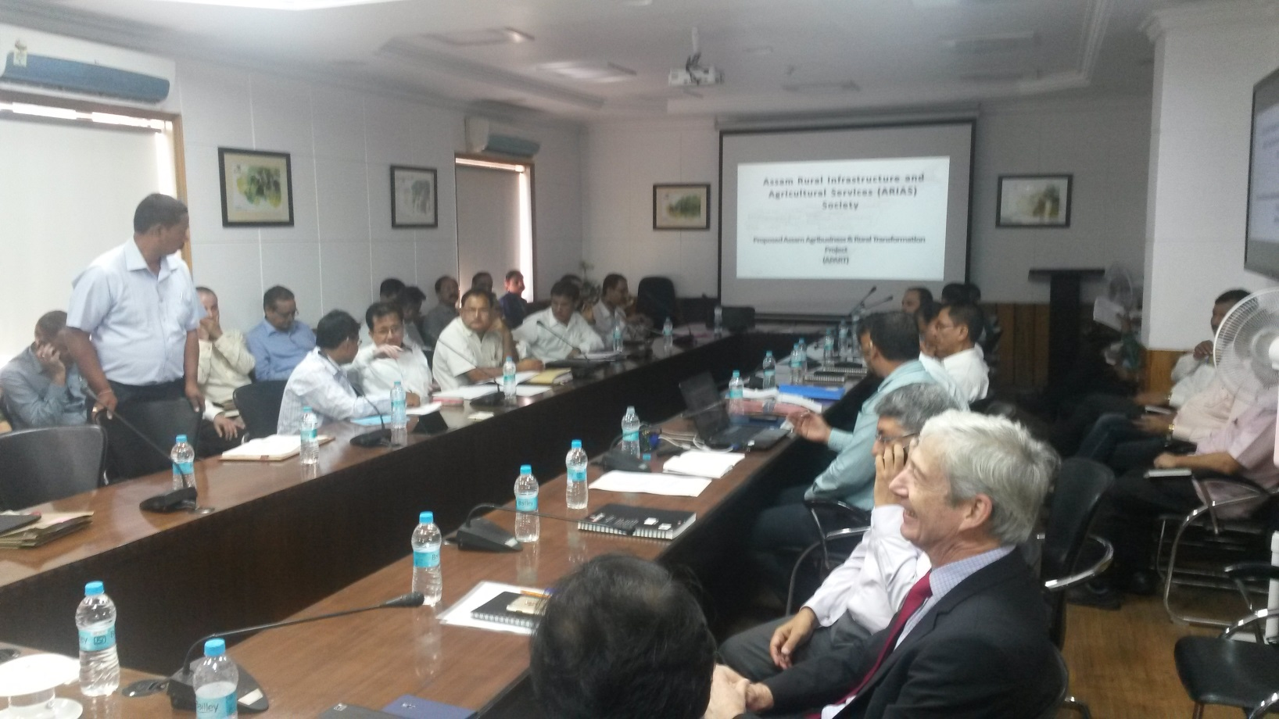
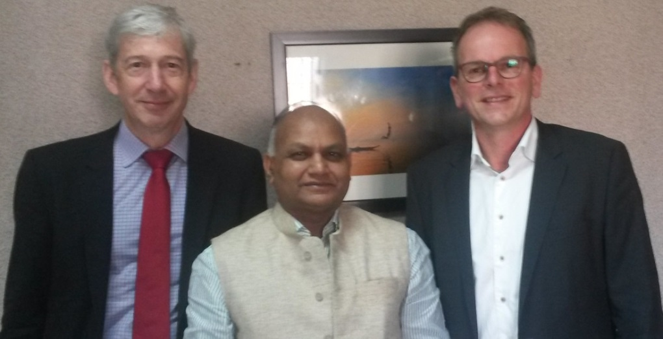
Presentation for Mr. V.K. Pipersenia, Chief Secretary Govt. of Assam

Slide 18
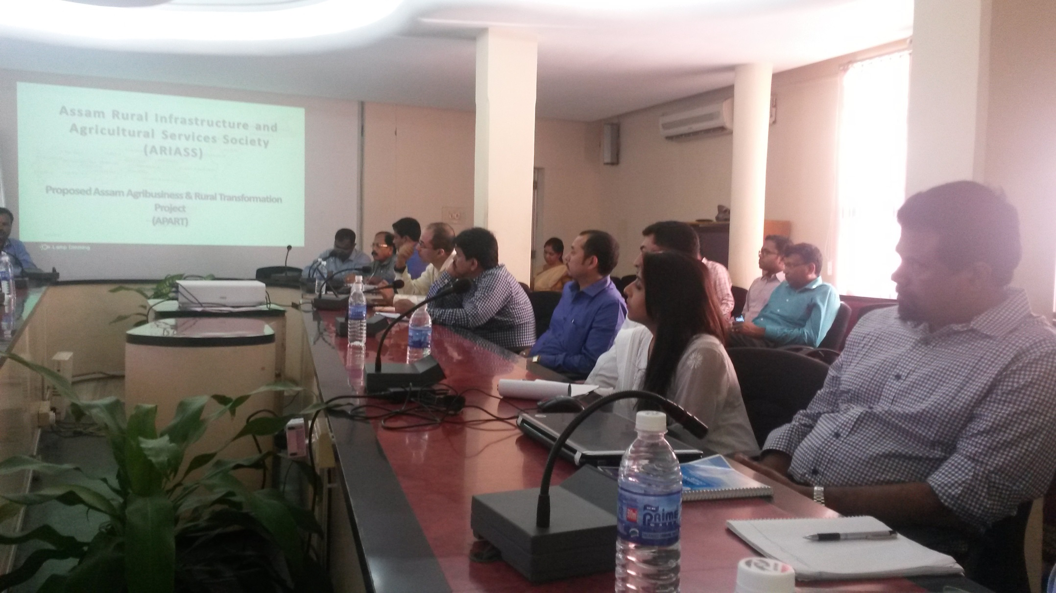
Meeting Private stakeholders in F&V supply chain

Slide 19
Conclusions: Request for proposal
Developing a Logistics Performance Index (LPI) for Assam and training the team of the Government of Assam (GoA) on the same;
Pilot implementation and redesign of agri-food value chains: closing cold chains, multimodal shifts, quality driven logistics in order to reduce losses, to decrease costs, to decrease lead time, to improve quality;
Short note on Wageningen’s expertise, past work etc. in pork value chain;
Support on Mega Food Parks (another program of Indian government: 4 parks are scheduled for Assam).

Slide 20
Draft Project proposal Assam submitted 6 December 2016
“Assam as East-West food gateway in North-East India: Improving the Agro-logistics in Assam India”
Pilot implementation and redesign of agri-food value chains: 180,000 euro
Support on mega food parks: 478,000 euro

Slide 21
Feasibility Study Public Private Partnership with the World Bank India.
Lesson learned, summary:
Mode of operation WBG Programs:
●Loan to implementers, usually national or local government
●Implementers responsible for purchase of material, hiring technical assistance
●For collaboration, providing technical assistance and inputs: good insights needed in program planning

Slide 22
Feasibility Study Public Private Partnership with the World Bank India.
Good insights in development of WBG programs:
●Whose role? Embassies, Min. of EZ/BuZa, Nl representatives with WBG, consortia private sector or their representatives.
●Involvement at program planning stage versus involvement at implementation stage: dilemma.
●Involvement in preparation: no longer eligible for implementation
●Involvement in implementation requies good insight in preparaition stages of programmes

Slide 23
Feasibility Study Public Private Partnership with the World Bank India.
Conclusions SMP:
To investigate the feasibility of collaboration with the WBG India for the Dutch Topsectors Agri & Food and Horticulture & Propagation Materials, and the options to implement the collaboration in a PPP set up.
Yes, further engagement with WBG offers very interesting but still relatively unexplored options and there are possibilities to bridge the perceived gap between Dutch PPP approach and WBG target group.
Main message: invest in getting to know WBG mode of operations and its implementation partners.

