Slide 1
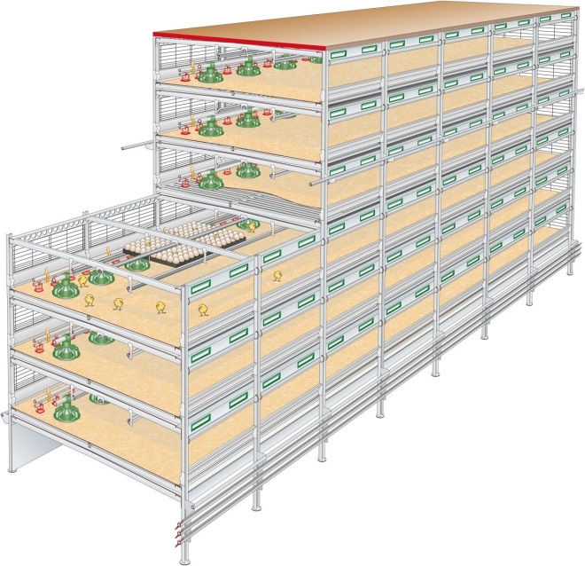



SMP Poultry Production Green Chain Revolution for China
Final report
- Peter Vingerling (Vencomatic Group) &
- Dr. Xin-Ying Ren (WLR)
13 Dec. 2016

Slide 2
Report setup
Consortium
Kick-off and progress
Feasibility study field trip
Conclusion & follow up

Slide 3
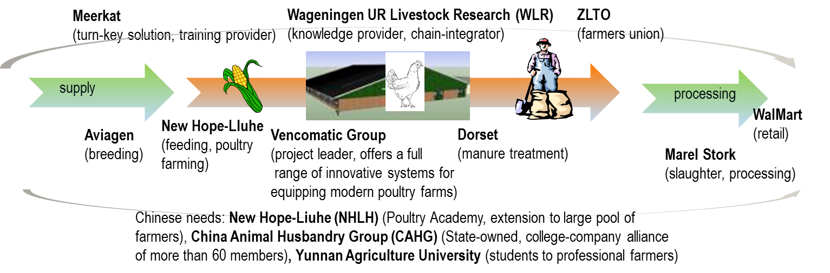
Project Consortium

Slide 4
Project kick-off & progress
Kick-off and progress
  31 March granted
  12 April inform consortium for kick-off
  28 April CAAS (Chinese Academy of Agri. Sci.) joined
  9 June CAAS visit Vencomatic
  10 June kick-off tel-con with consortium, follow up by sending questionnaire to partners, who were very supportive by then
  15 July discussion of questionnaire results and prepare Sept field visits; NHLH (New Hope-Liuhe) dropped off due to intern re-organization
  5-11 Sept feasibility field trip to China, details in later slides
  2 Nov. midterm SMP review
  18 Nov. Wens Group (the biggest poultry & pig production integrator in China) visited Vencomatic, potential partner for future steps
  13 Dec. final report

Slide 5
Project feasibility study field trip
1. Meeting Walmart (with Will Watts, Director International Corporate Affairs)
  Food Safety Centre opening in October 2016
  Walmart is collaborating with Shengnong on Poultry Excellence project, can share the contacts
  Discussion on foodborne diseases

Slide 6
Project feasibility study field trip
2. Visit CAHG largest state-owned enterprises (SOEs) in animal husbandry & biggest producer of veterinary drugs and vaccines
comparison | NL | CN
FCR | 1.56 | <2
Chick/m² | 24 | <20
Costs
Raw building | 260€/m²
Building stall | 15€/h
electrician | 40€/h
Discussion points
Can collaborate with CAHG enterprise-college alliance (>60 members) to promote advanced NL knowledge & technology
Recommend to visit Jiangsu Agri-Livestock College (a member of CAHG enterprise-college alliance), where Vice-President WANG Yang visited before and appointed it to be the national-level demo site for agri-livestock integration system

Slide 7
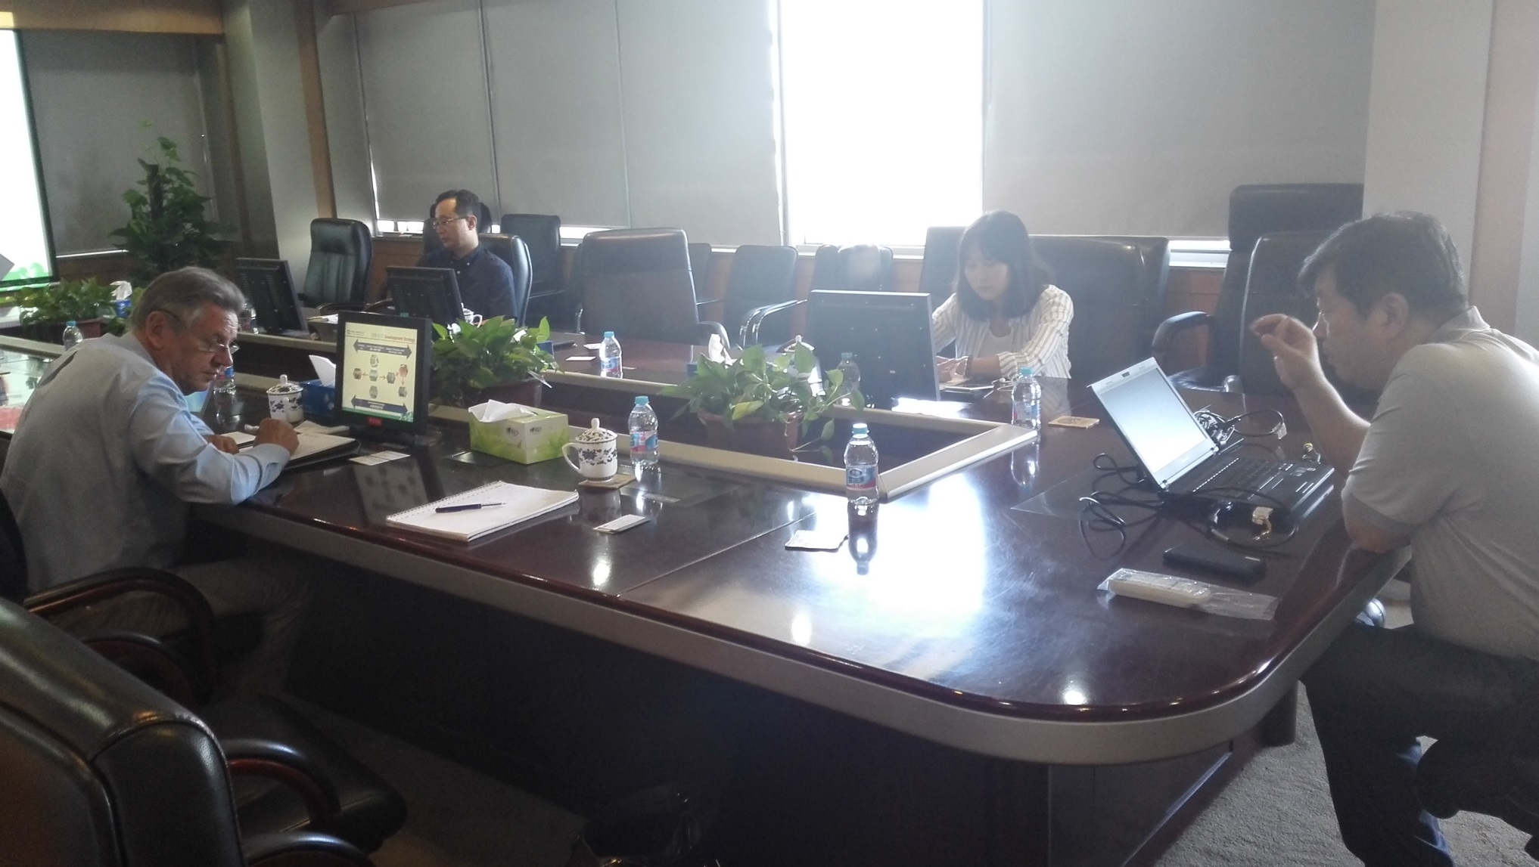
Project feasibility study field trip
2. Visit CAHG

Slide 8
Project feasibility study field trip
3. Visit CAAS with Dr. WU Shugeng, Feed Research Institute
What’s needed to bring new tech to China?
  Equipment/facilities for large-scale safety production
  Increased food safety, reduced antibiotics use
  Reduced environment problems and increased biosecurity
Patio system could be adopted in China:
  Local government wanted such system with so many good features, could apply for local government funding support
  Local farmers wanted
  Need to have quality managers at the client company
The broiler expert in CAAS is Dr. WEN Jie (wenjie@caas.cn) , vice-director of livestock institute of CAAS
WPC highlights & opportunities
  No antibiotics
  On-farm hatching (in CN, Wens Group & CP group have such tech)
  Around 10 big stakeholders in poultry sector

Slide 9
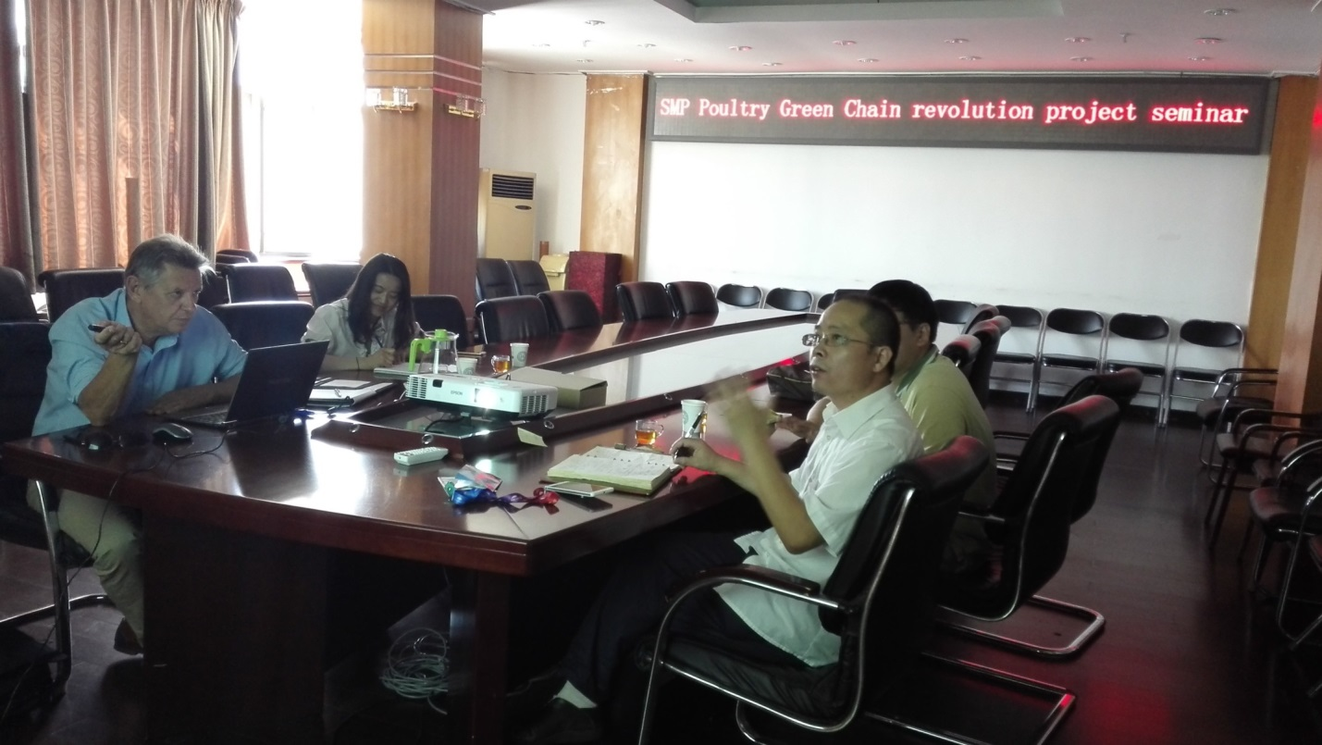
Project feasibility study field trip
3. Visit CAAS
  Recommended to collaborate with Wens Group
 | CN | remarks
Rejection rate | 1%
PI (production index) | <355
Days for meat | 55 days | KFC: 35 days to 2.2kg
FCR | 1.7
Max. kg/m² | 30-40
Chicks/m² | 15 | 2.5kg (eg. 40kg/m²)
Cost price per kg produced live weight | €
Housing | 0.077
Direct | 0.093
Chick | 0.128
Feed | 0.548

Slide 10
Project feasibility study field trip
4. Jiangsu Agri-Animal Husbandry Vocational College
Around 14,000 students, 1000 teachers, 350 ha land, ranks no. 1 in China all vocational trainings
Funding 30 million RMB from governments (MoA, Provincial S&T, Agri. Departments); 3 million RMB from companies
Collaborating with companies: Mengniu, Wens Group, Yurun Food Group; mostly join shares with technologies; eg: Sujiang pig breed, this school invested in technologies and account for its 40% shares
>50 staffs / year were sent abroad for training, to 3 fixed projects: UC Davis; Australia New South Wales Colleges of TAFE and Germany
They would like to collaborate with WUR on exchanges
Its Agri-Livestock integrated park has more than 300 ha land, inside has museum, gene bank of waterfowl, fruit gardens (with chicken, ducks under the trees), local pig breeds conservation, entertainments etc. very nice demonstration. No wonder Vice-President of China appointed here as national-level demo site
TANG Xianwen | Jiangsu Agri-animal husbandry vocational college | Director of Foreign Affairs Office
Teacher JI | .. | Poultry expert
 |  | Translator Foreign Affairs Office

Slide 11
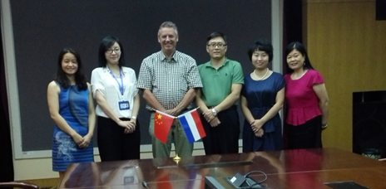
Project feasibility study field trip
4. Jiangsu Agri-Animal Husbandry Vocational College
SMP poultry project collaboration discussion:
They are very interested in Patio system
Welcomes the project to set up a Patio demo at their Agri-livestock national level demo park, also has whole-chain possibility and capability
Could apply local government funding and all sources together
Ideal training, extension station for its students, teachers, and neighbouring area farmers, as well as member companies and schools of the CAHG alliance, radiating whole China
Jiangsu is one of the largest poultry production area, also close to Shanghai, can supply Shanghai metropolitan area, therefore, could set up demo here
Have close relation with SOE like CAHG and National-level leader’s support

Slide 12
Project feasibility study field trip
5. Visit Jiangsu Huashi Co. Ltd. a broiler integrator, with Chairman Mr. WANG Kuanhua and his crew
The largest broiler production whole chain company (integrator) in Jiangsu, a state-key enterprise
Produces 50 million commercial birds, 200,000 tons feed
Has 200,000 breeder herds -> will reach 500,000 this year, parent stock birds are: Aviagen, Ross 308 etc.
Slaughter 100,000 birds per day -> will reach 150,000 per day till year end
Exports to Japan, S-E Asia, middle agencies
Target market put emphasis on price and quality
Has special innovative poultry farming system: ‘farming on elevated net’
Has already collaboration with Meyn and bought their equipment
Would like to collaborate more with Dutch companies and technology
Complained that Dutch are too slow in doing business

Slide 13
Project feasibility study field trip
Has special innovative poultry farming system: ‘farming on elevated net’

Slide 14
Project feasibility study field trip
5. Visit Jiangsu Huashi Co. Ltd.
Discussion points
It is the first time for them to learn about ‘on-farm hatching’, and they are interested
But they questioned a lot about how vaccination (which is a must in China) could be done by on-farm hatching and the feasibility of ‘no antibiotics use’
Everybody agrees that food safety is the first thing they care as consumer
They can consider setting up one Patio pilot there to compare performance

Slide 15
Project feasibility study field trip
6. Visited Jiangsu Huashi’s best performance broiler farm, some data:
 | Integrator’s best farm | remarks
Days for meat (per round) | 37 days | To 2.5kg, 9 rounds/ year
FCR | 1.55
Stall size | 115m*13.5m | 7 stalls in total
Birds/stall | 15,000
Rejection rate | 0 | as it’s their own farm
Flock density (bird/m²) | 10-11
Death rate | <1%
Costs (default, per bird) | RMB
bird | 20 RMB
Feed | 16 RMB
Per stall | 300,000 RMB
Electricity | 10,000 RMB/round of production, 7 stalls together
Water
Labour
Coal | 0.3 RMB / bird
profit | 3-4 RMB/ bird
Manure | 20 RMB / truck | Bringing away

Slide 16
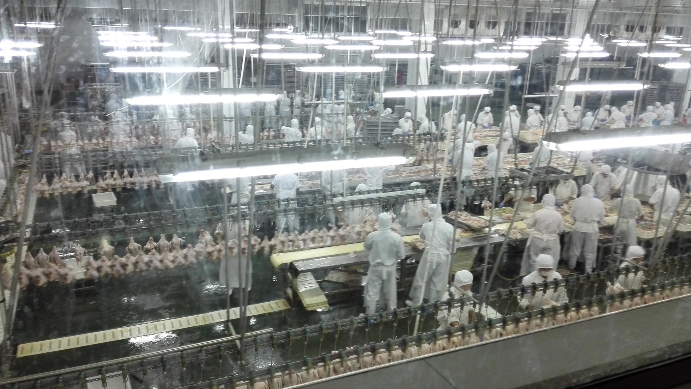
Project feasibility study field trip
7. Visited Jiangsu Huashi’s slaughter house

Slide 17
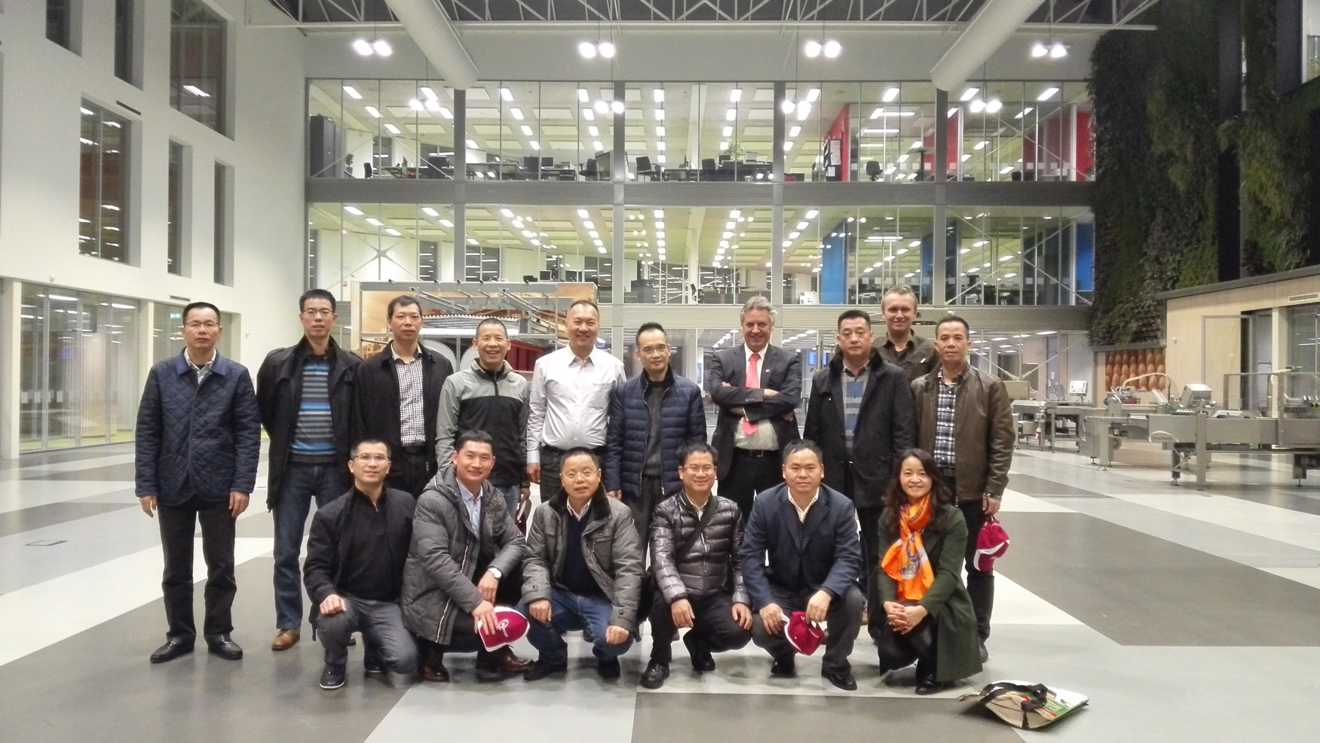
Project feasibility study field trip
8. Wens Group visited Vencomatic Group
  48 billion RMB sales
  Yellow bird, account for 25% of China production
  Interested in Rondeel & Patio systems, could be the next PPS or contract research partner in China

Slide 18
Project summary & follow up
Discussion
From the beginning all Chinese partners were enthusiastic and collaborative
Completed questionnaire survey but no concrete pilot project was discussed;
On a later stage, New Hope-Liuhe dropped off due to intern reorganization of their Poultry Academy; and academics don’t have commercial goals. Their questionnaire was poorly answered and it seems defensive reasons were main reasons to join in.
The best biggest poultry integrator partner in China seem to be Wens Group, they seem also to be interested to collaborate further. But they are basically exploring yellow featherd (slow growing) birds and patio needs white feathered birds.
Role of Chinese local authorities still not clear. Possible subsidies are mentioned but how they can be obtained and conditions etc. still not clear

Slide 19
Project summary & follow up
Discussion
  -The use of growth hormones and antibiotics hinders the discussion on ROI
  -The vaccination in Patio is discussed various times but partners doesn’t seem to accept the fact that this can be done in OVO
  Low stocking densities, poor housing conditions and traditional cage management experiences hinder the discussion to use Patio as an alternative
  Walmart can play a positive role in setting up a demo project
  With a single exception Dutch partners were not very interested in progress and were too busy to join on field trip

Slide 20
conclusions
Most Chines companies are investigating new production methods, mainly in order to reduce use of antibiotics
Coming months all visited organisations will be invited to come over to Holland and to discuss the possibilities of a demo project for China
It is not usefull to think of a PPS as long as no clear commitment is received from a Chinese company
The help of Dutch agriculture attaché’s will be asked in order to get a more clear picture of the willingness of the Chinese (local) government to invest in a demo project

Slide 21
Thanks!
Text

