Slide 1
Presentation for SMP 16015
Adaptation of Dutch Livestock Manure Treatment System into Chinese Situation
Jie YAN Jie.yan@wur.nl
Manager Wageningen UR China office
Roland Melse & Fridtjof de Buisonje
Researchers Wageningen Livestock Research
Walter Veenhuis
Veenhuis Machines BV
Almelosestraat 54 | Postbus 35, NL-8100 AA Raalte
www.veenhuis.com

Slide 2
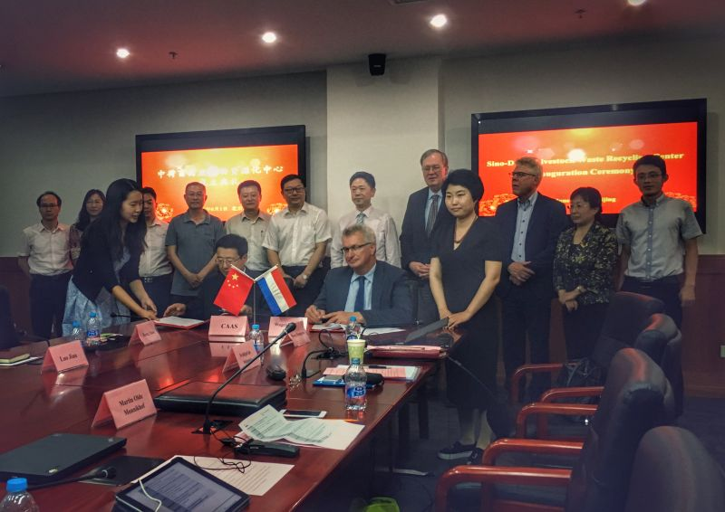
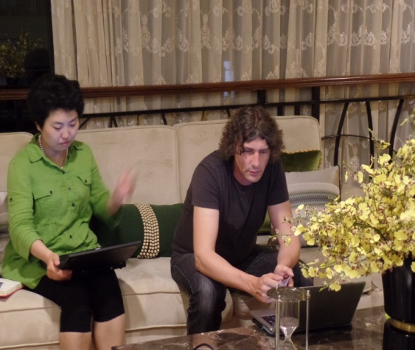
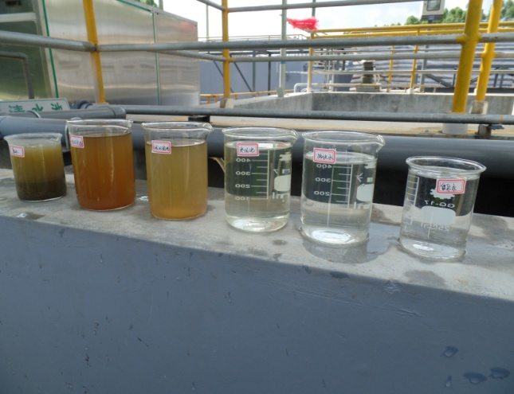
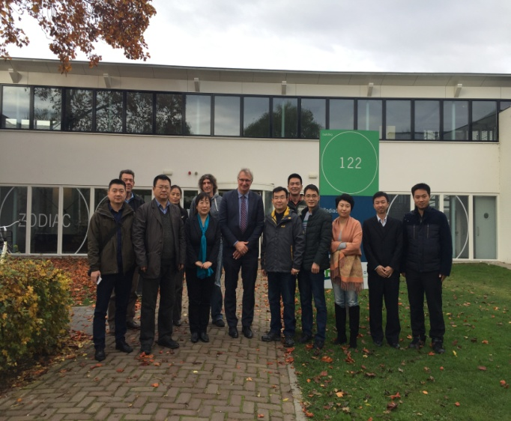
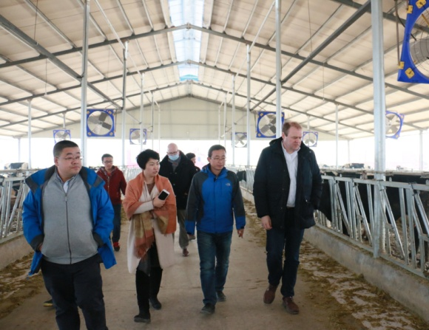
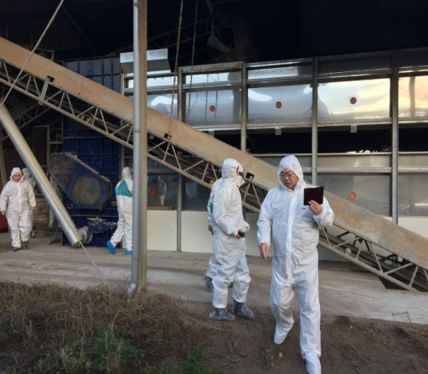
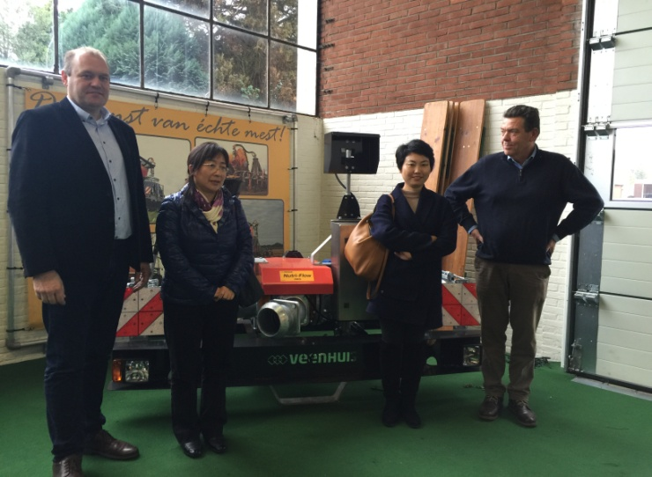
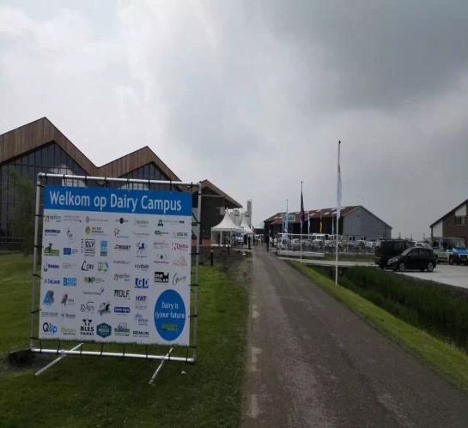
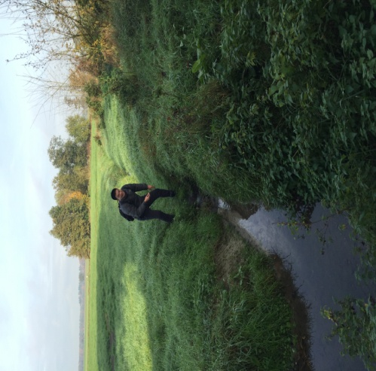
Project and aim
To build up a Sino-Dutch Consortium with companies and research institutions from two countries (achieved)
To organize field trips to Chinese and Dutch livestock farms to understand each other’s practice and situation
To identify what technology and infrastructural system can be adapted to China (achieved)
To aim at setting up a Sino-Dutch cooperation center to do the preparations for concrete design and adaptation of the systems and extension to markets. (achieved)
Notes:
Sino-Dutch livestock waste recycling Centre

Slide 3
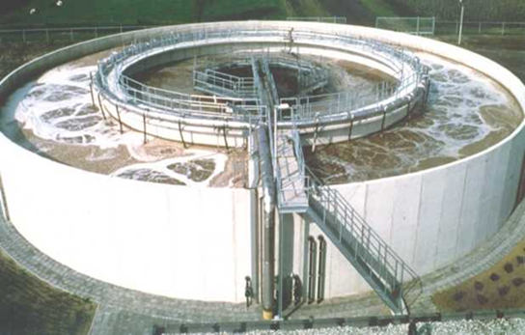
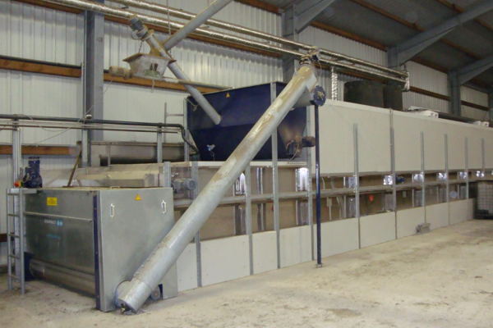
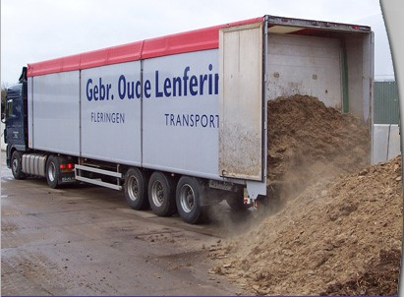
Popular manure treatment technologies in the Netherlands

Slide 4
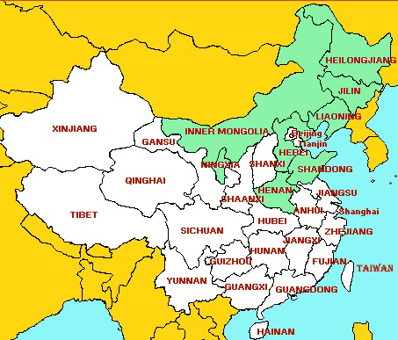
Slurry Management Scenarios identified for China
Scenario1 slurry application to arable farms
Scenario2 biological treatment
Scenario3 Reverse Osmosis system
Senario 2 and 3 can almost suit any area, except the investment for facilities is relatively much higher than Senario 1.
Senario 1 is basically the easiest and cheapest way for slurry treatment, however, it has relatively high request to topography, transportation, and availability and accessibility of arable farms.
Notes:
application of untreated manure and separation products (solid and liquid fractions) on arable farms,
biological treatment (nitrification/denitrification) and application of separation products (solid fraction and sludge) on arable farms, discharge of effluent into the sewer,
advanced separation by Reverse Osmosis and application of separation products (solid fraction and NK-concentrate) on arable farms, discharge of effluent into surface water.

Slide 5
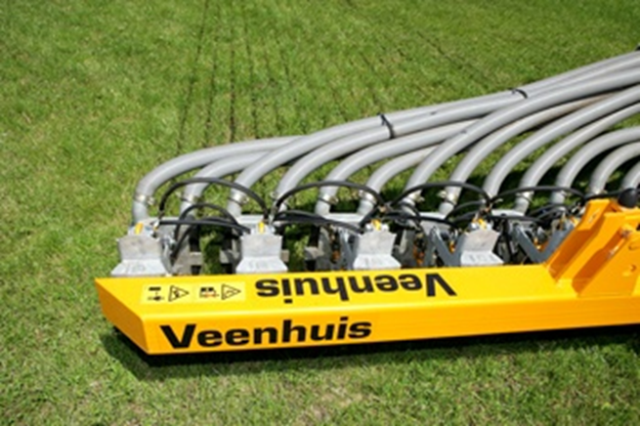
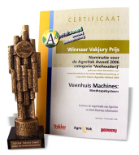
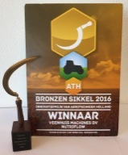
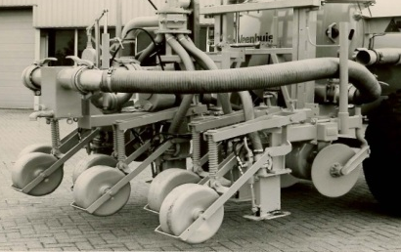
Company introduction
Ownership: 100% family owned company (mr Walter Veenhuis)
Size: 50 fte
Main activities: Machines for:
Manure transportation
Manure application and injection
Manure treatment (separation and composting)
Realtime manure analyses by NIRS technology
Main sales-areas: Benelux, Germany, United Kingdom, USA and Canada
Full-range supplier of manure-handling equipment for liquid organic manure
!!! 40 years of experience in manure injection !!!
1975
1978
1982
1988
1992
1998 - 2016

Slide 6
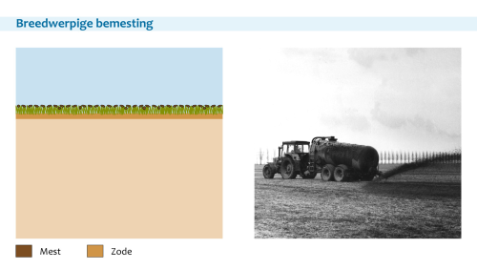
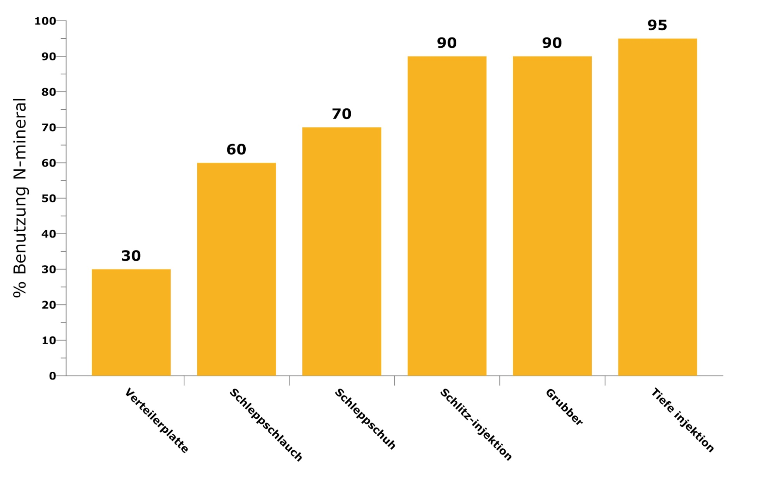
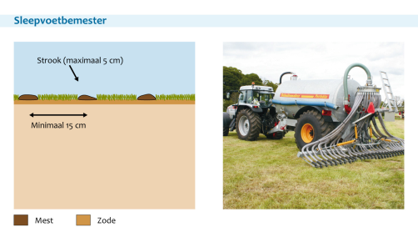
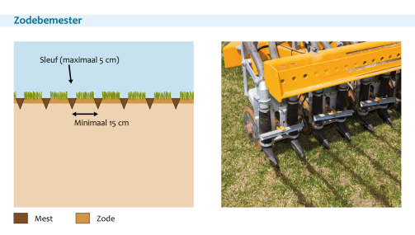
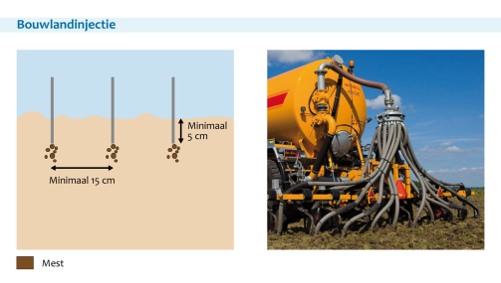
Efficiency of application methods
Surface spreading with splash-plate
Deep-leg injection
% Utilization of N-mineral
Trailing-shoe applicator
Shallow Disc-injector
Arable injector
Splash-plate/
surface spreading
Trailing-hose
Trailing-shoe
Arable injector
Deep-leg injection
Disc injector
Source: WUR / PBL

Slide 7
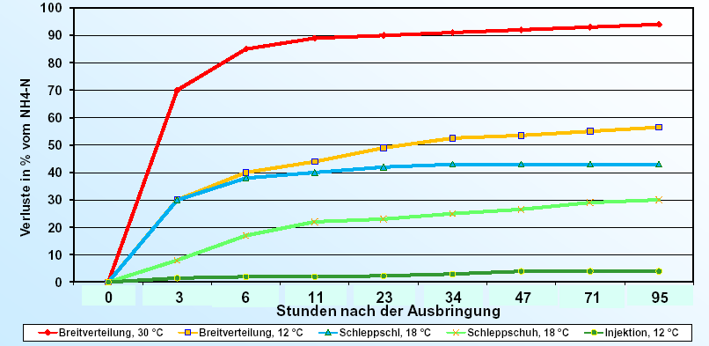
NH4 losses of manure application in relation to temperature and application method
Loss in % of NH4-N
Hours after field application
Splash-plate, 30°C
Splash-plate, 12°C
Trailing-hose, 18°C
Trailing-shoe, 18°C
Trailing-shoe, 12°C
Source: Landmaschinenschule Triesdorf

Slide 8
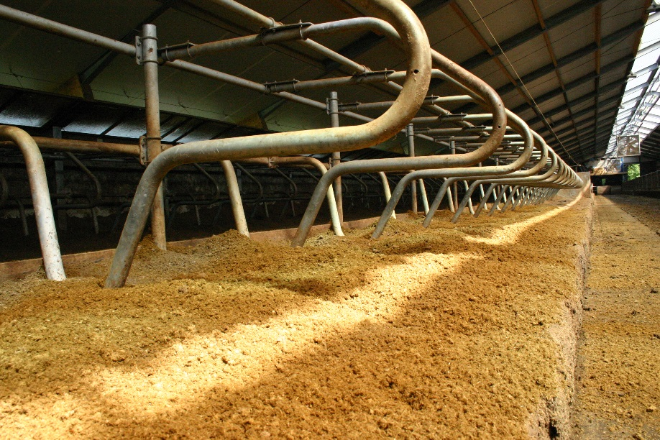
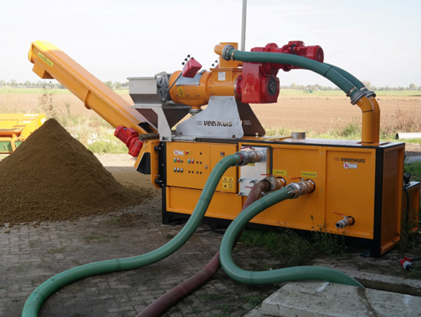
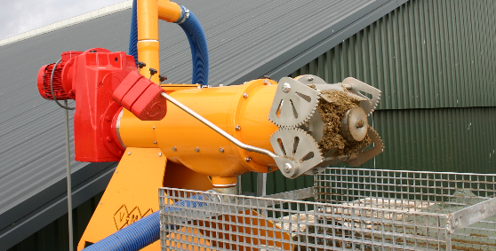
Manure separation for bedding
Volume reduction (less storage of liquids)
Costsaving on transport of manure
Different contents, optimum manure planning
Saving on sawdust
Composting / Hygiënisation

Slide 9
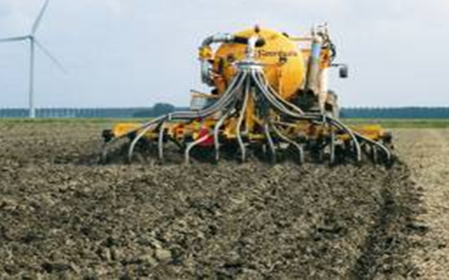
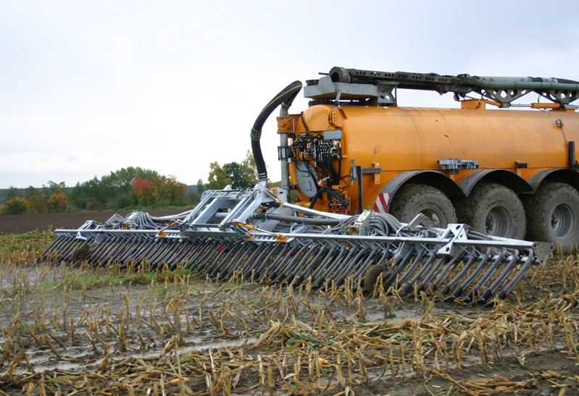
Available low-emission application technologies
Shallow Disc-injector
Arrable injector
Surface spreading (splash-plate)
Trailing-hose applicator
Trailing-shoe applicator

Slide 10
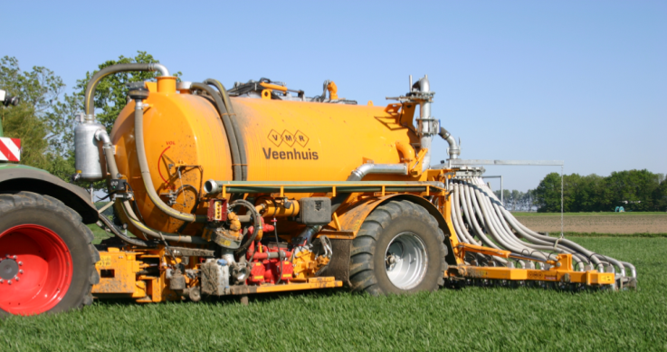
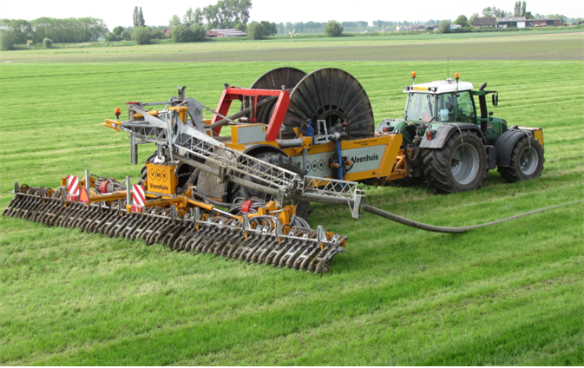
Wide range of tanks and supply-hose system available

Slide 11
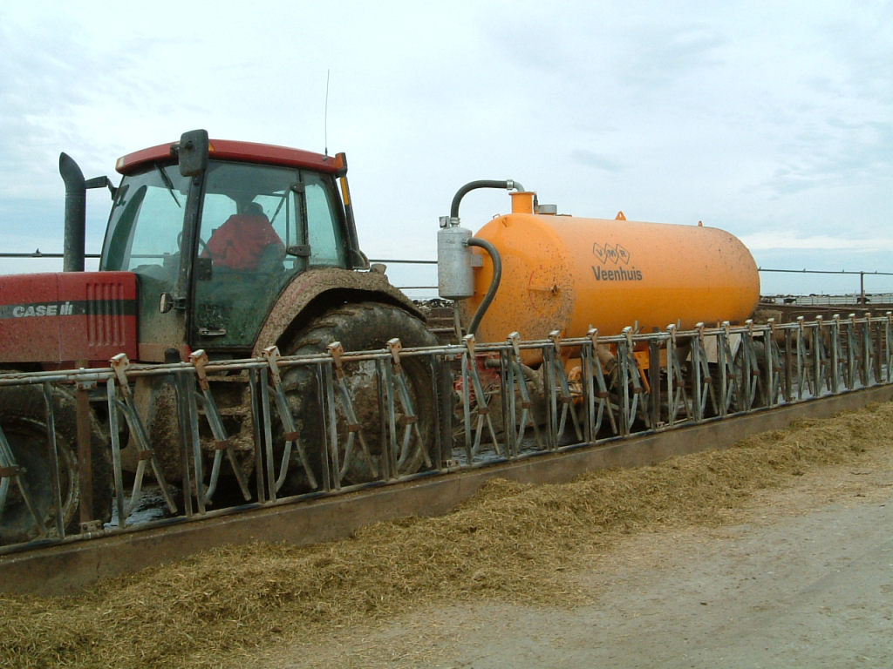
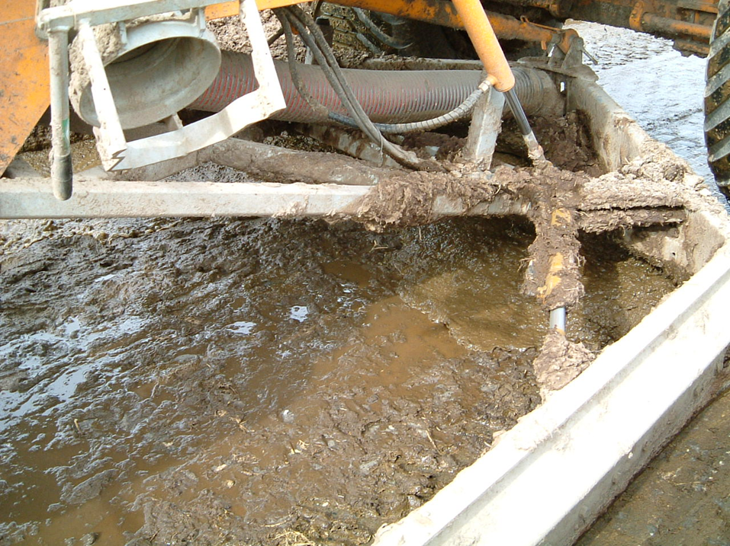
Tank with alley-scraper

Slide 12
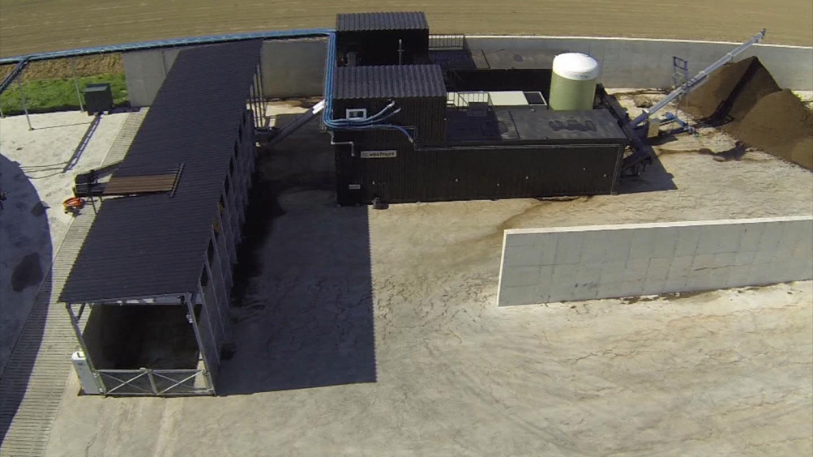
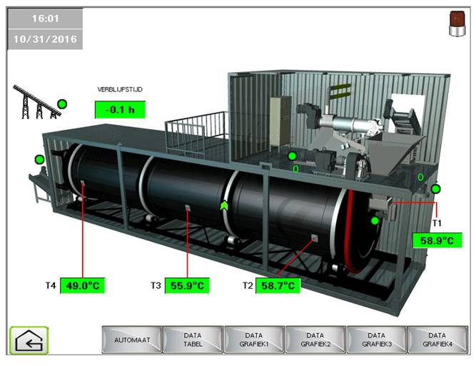
Manure separation and composting equipment

Slide 13
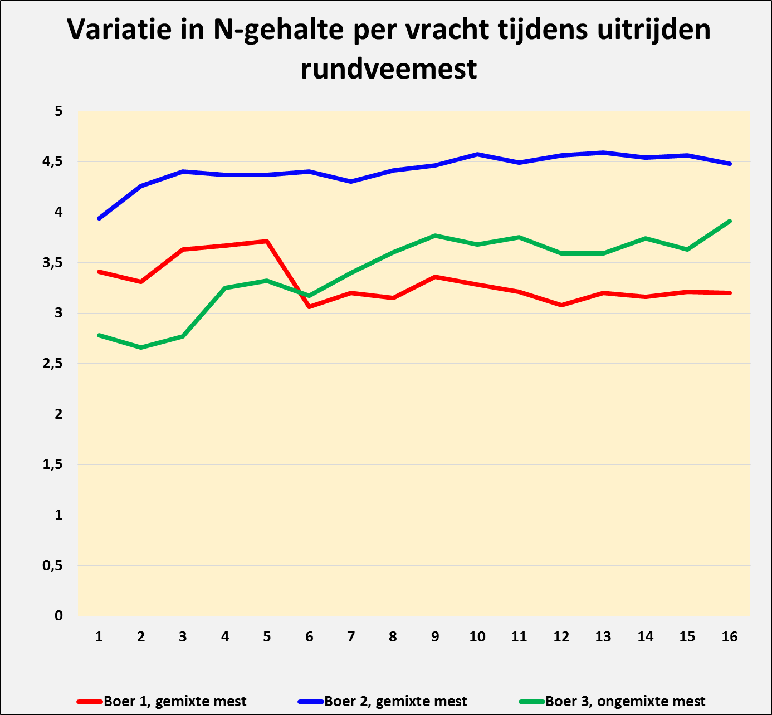
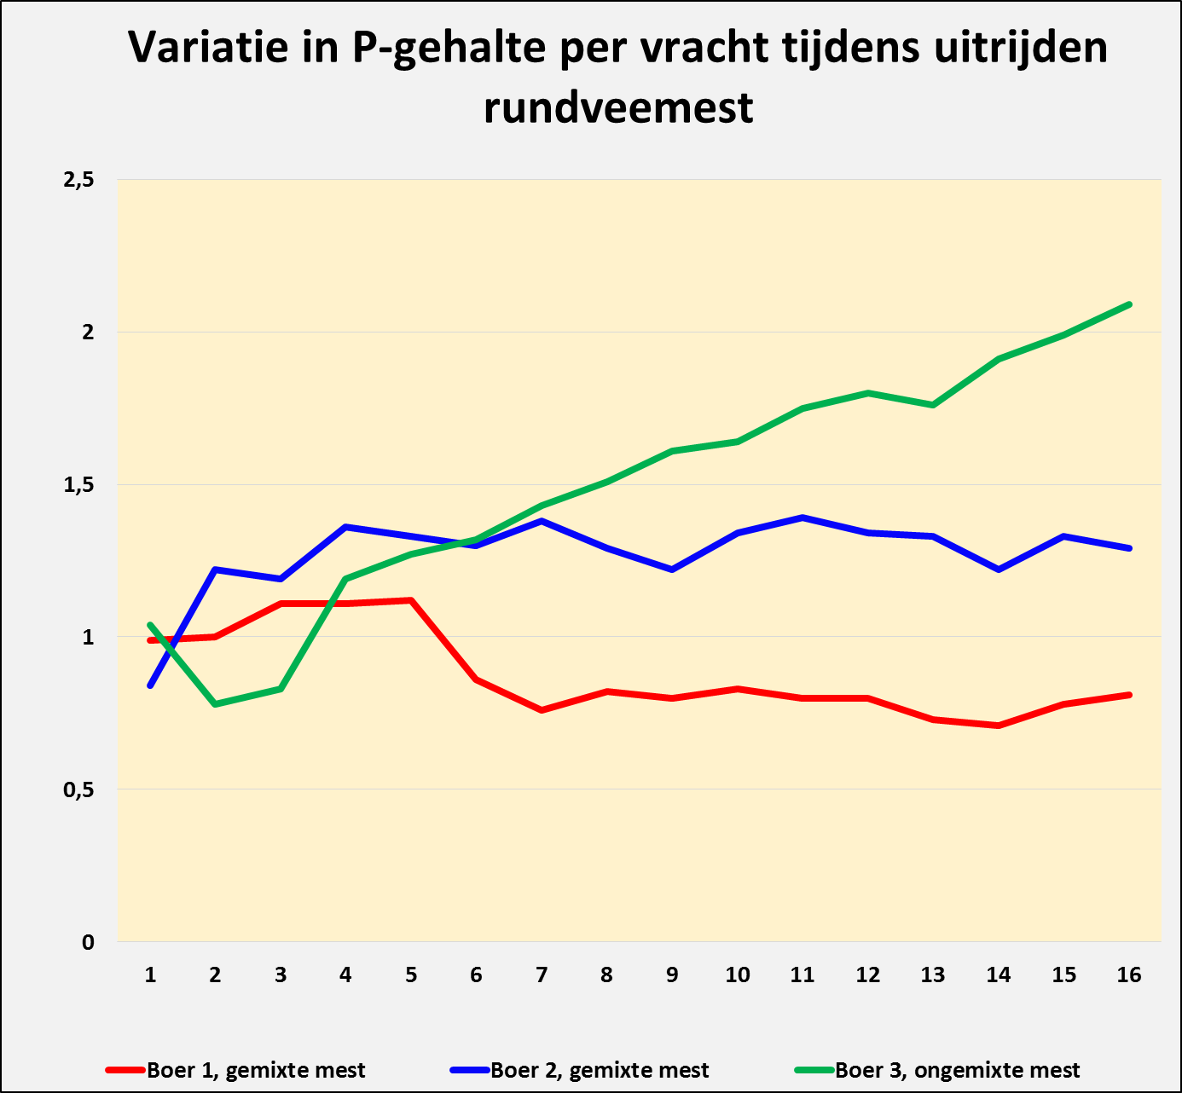
Realtime manure analysing with NIRS technology
Variation in N-content per load during application of dairy manure from one farm
Farm #1, mixed
Farm #2, mixed
Farm #3, not mixed
Precision manure-application with Veenhuis NutriFlow system:
Variable dosage based on continuous realtime NIRS analyses
Automatic section control; no overlapping
Automatic variable adding of liquid N-fertilizer for optimum N and P dosing
Isobus control; commicates with farm software, s.a. Farmworks or Akkerweb, a.o.
Variation in P-content per load during application of dairy manure from one farm
Farm #1, mixed
Farm #2, mixed
Farm #3, not mixed

Slide 14
Businessplan top Chinese Market
Knowledge and experience on (liquid) manure handling widely available
Required technology is available:
Slurry tankers to move and spread liquid slurry
Application and injection systems to apply liquid manure to land/crops
Separation and composting technology available
High-tech solutions for future demand already available today
This technology offers solution to Dairy + Pig manure problems and Digestate from biogas plants in China
Knowlegde about segmentation of Chinese market is missing
Distribution is missing
Funding for research and market-entry required

Slide 15
Next steps
Teaming-up with Dutch and Chinese researching institutes
Finding and selecting Chinese distribution partner(s) for dairy, pig and biogas industry
Selecting the right products from existing product-range
Introducting first products to Chinese market in a Pilot project
Find funding for required investment from both sides
Support project with Dutch knowledge and experience
Eventually, setting up local production of machines

