Slide 1



Gut microbiota and metabolic health: hype or hope?
AgriFoodTop
Symposium
7 juni 2017, Wageningen

Slide 2

De prevalentie van obesitas en type 2 diabetes mellitus neemt toe
Key facts WHO, 2015
Worldwide obesity has more than doubled since 1980.
39% of adults aged 18 years and over were overweight in 2014, and 13% were obese.
Most of the world's population live in countries where overweight and obesity kills more people than underweight.
42 million children under the age of 5 were overweight or obese in 2013.
Obesity and related complications are preventable.

Slide 3
Achtergrond
De diabesity pandemie kan niet verklaard worden door geidentificeerde gen-omgevingsinteracties
Gut microbiota produceren metabolieten die onze stofwisseling kunnen beinvloeden en daarmee een rol kunnen spelen bij de regulering van ons lichaamsgewicht en insuline gevoeligheid
Obesitas en Type 2 diabetes mellitus zijn geassocieerd met een veranderde samenstelling en functie van onze darmbacterieën
Interventies die de microbiota moduleren kunnen het risico op obesitas en type 2 diabetes mellitus beinvloeden
Met name gebaseerd op diet experimenteel onderzoek

Slide 4
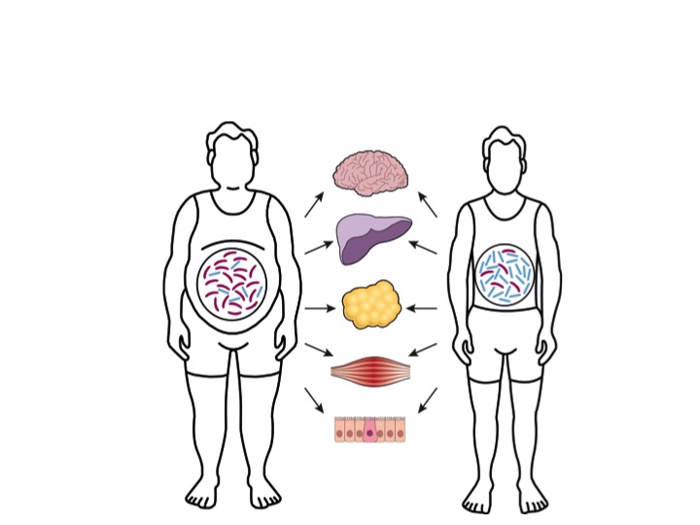

Relatie microbiota en gezondheid
Objective TIFN project GH003:
To provide information on the significance and mechanisms involved in the relation between gut microbiota, energy balance and insulin sensitivity in man, as a base for nutritional strategies in the prevention and treatment of obesity and T2DM.
Approach: linking ‘state-of-the art’ detailed human phenotyping and detailed characterization of gut microbiota composition and functionality to fill the gap between gut microbiota and human energy metabolism.
Notes:
Not only in mice, but also in humans there is a different composition in lean and obese, and between diabetic and non diabetic. And this has been linked to metabolism at different levels. For example, gut satiety signaling to the brain, insulin sensitivity at the level of the liver and muscle, fat storage and lypolysis in the adipose tissue and a the level of the gut itself. But, we the exact mechanisms are still unknown.

Slide 5





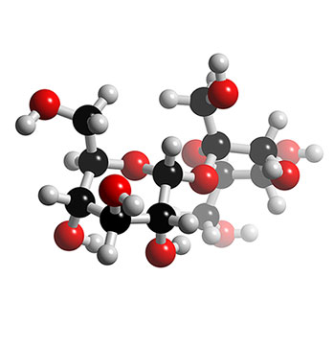
Projectopzet: Microbiota, energy balance and metabolism
Human metabolic studies
Koala children cohort
Microbiota quantification
-antibiotics
-SCFA administration
-feces transplantation
-
Microbiota
Complex CHO
Monosac-
charides
In vitro mechanistic deepening: adipose tissue, muscle
SCFA
GPR
GPR
Model development
Metabolism
Knowing diet-microbiota-host metabolism interactions:
strategies for optimal body weight control and
diabetes prevention: human intervention study

Slide 6



Humane studies: Antibiotica interventie
56
wk 1 pre
wk 2
2d wash out
wk 3 post
wk 8 follow-up
AMOXCILLIN
PLACEBO
VANCOMYCIN
40-70y
IFG/IGT
HOMA-IR>2.2
1500mg/day
7days
Notes:
We manipulated the microbiota by use of antibiotics. One broad sprectum, the Amoxicillin, and one only against gram positive bacteria, which is Vancomycin. The study population consisted of 56 obese or overweight men, who had impaired fasting glucose or impaired glucose tolerance and were insulin resistant.

Slide 7
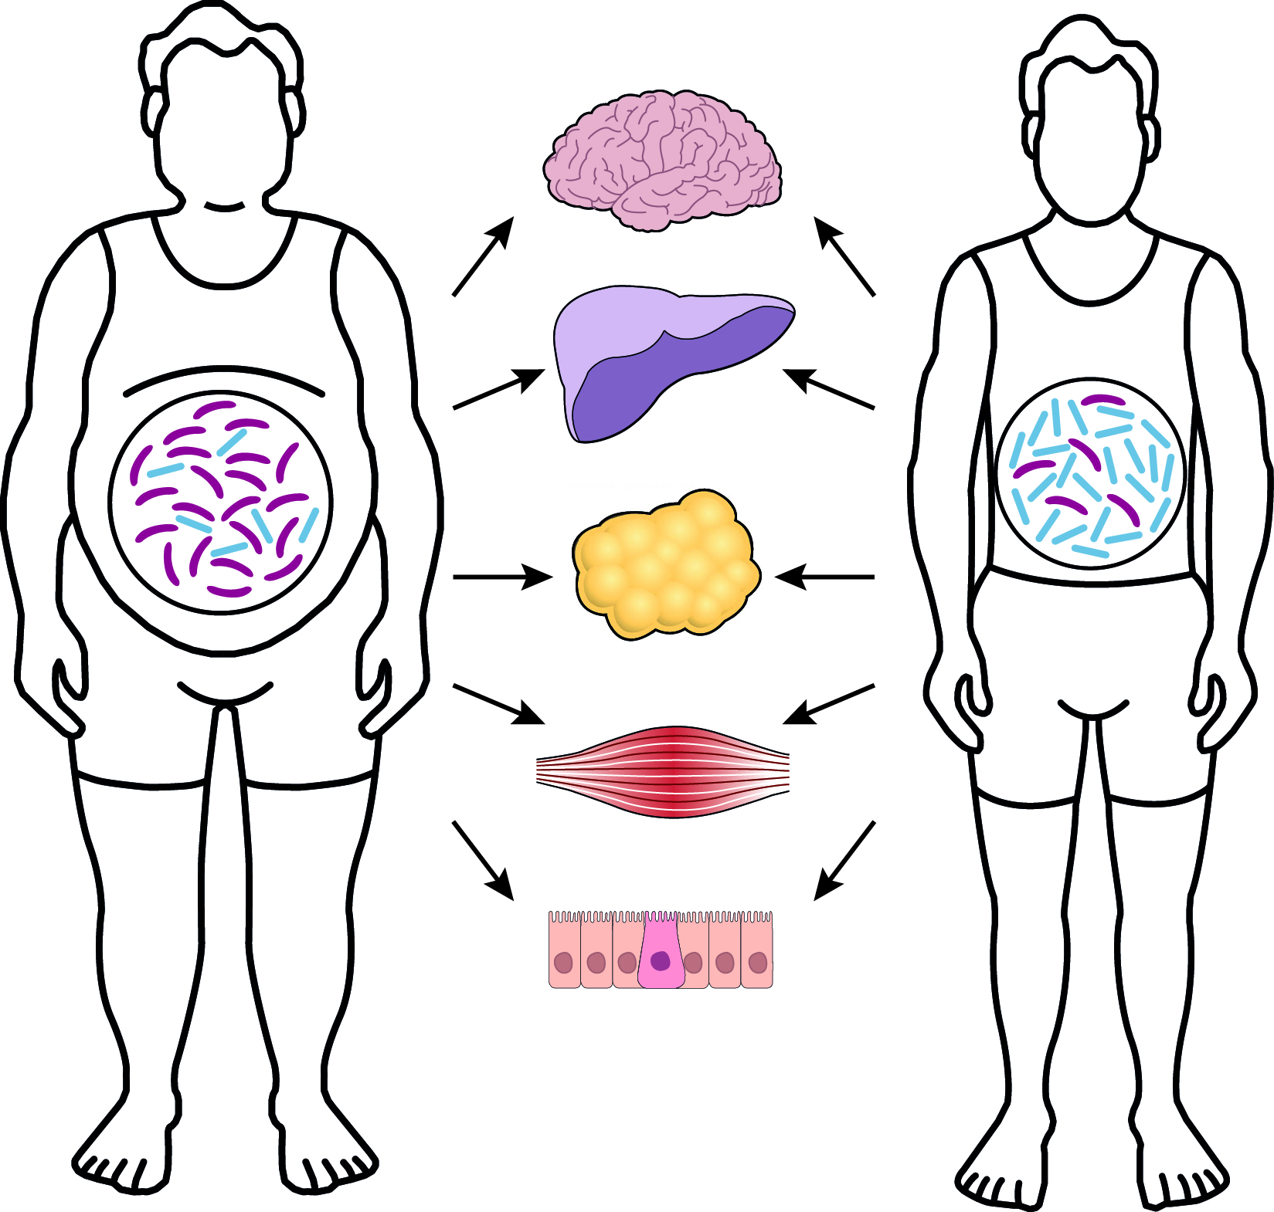
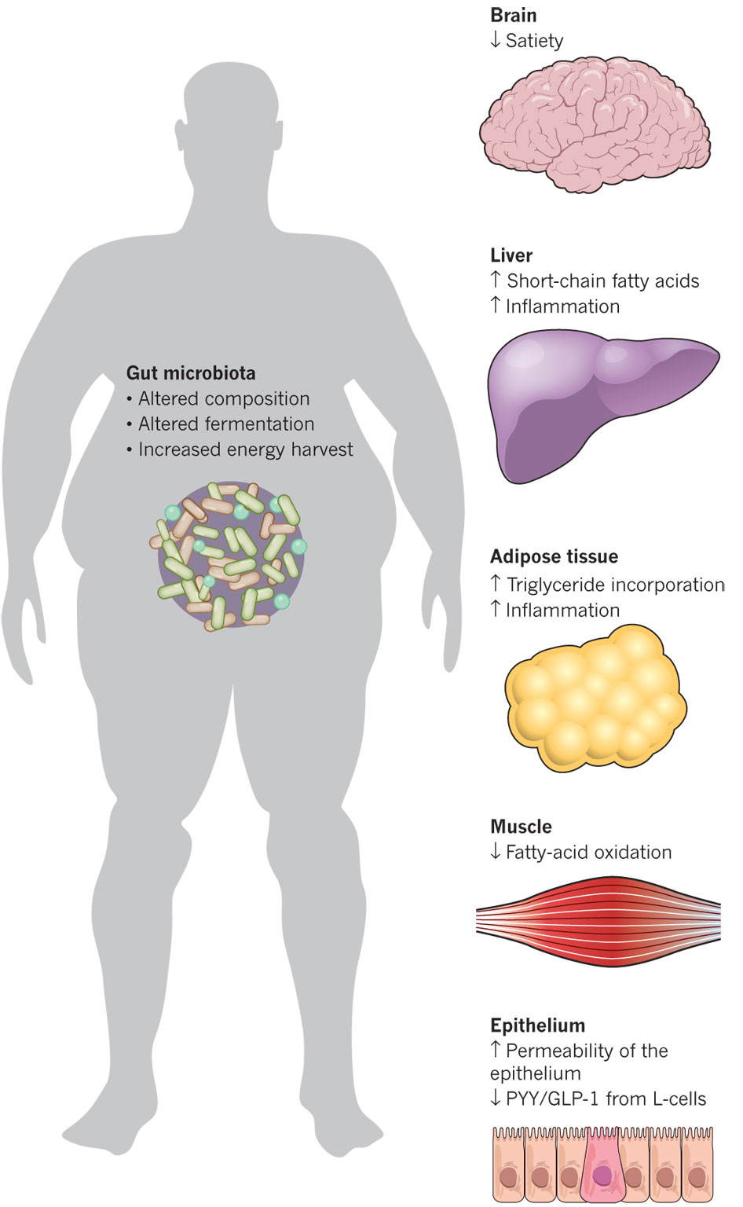
Methoden antibiotica interventie
Hyperinsulinemic clamp
Indirect calorimetry
Meal test
Adipose tissue and muscle biopsies
Gut permeability test
Feces collection
Notes:
The participants came to the universtiy for serveal measurements. We started with a clamp to determine insulin sensitivity, substrate oxidtion and energy expenditure with the ventilated hood, we determined gut permeability,we measured the postprandial response after a high fat meal, we took biopsies and the participants collected feces.

Slide 8
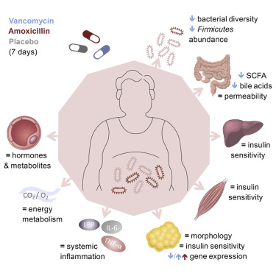
Verandering in microbiota (antibiotica) geen effecten op onze stofwisseling en insuline gevoeligheid
Reijnders et al, Cell metabolism, 2016

Slide 9
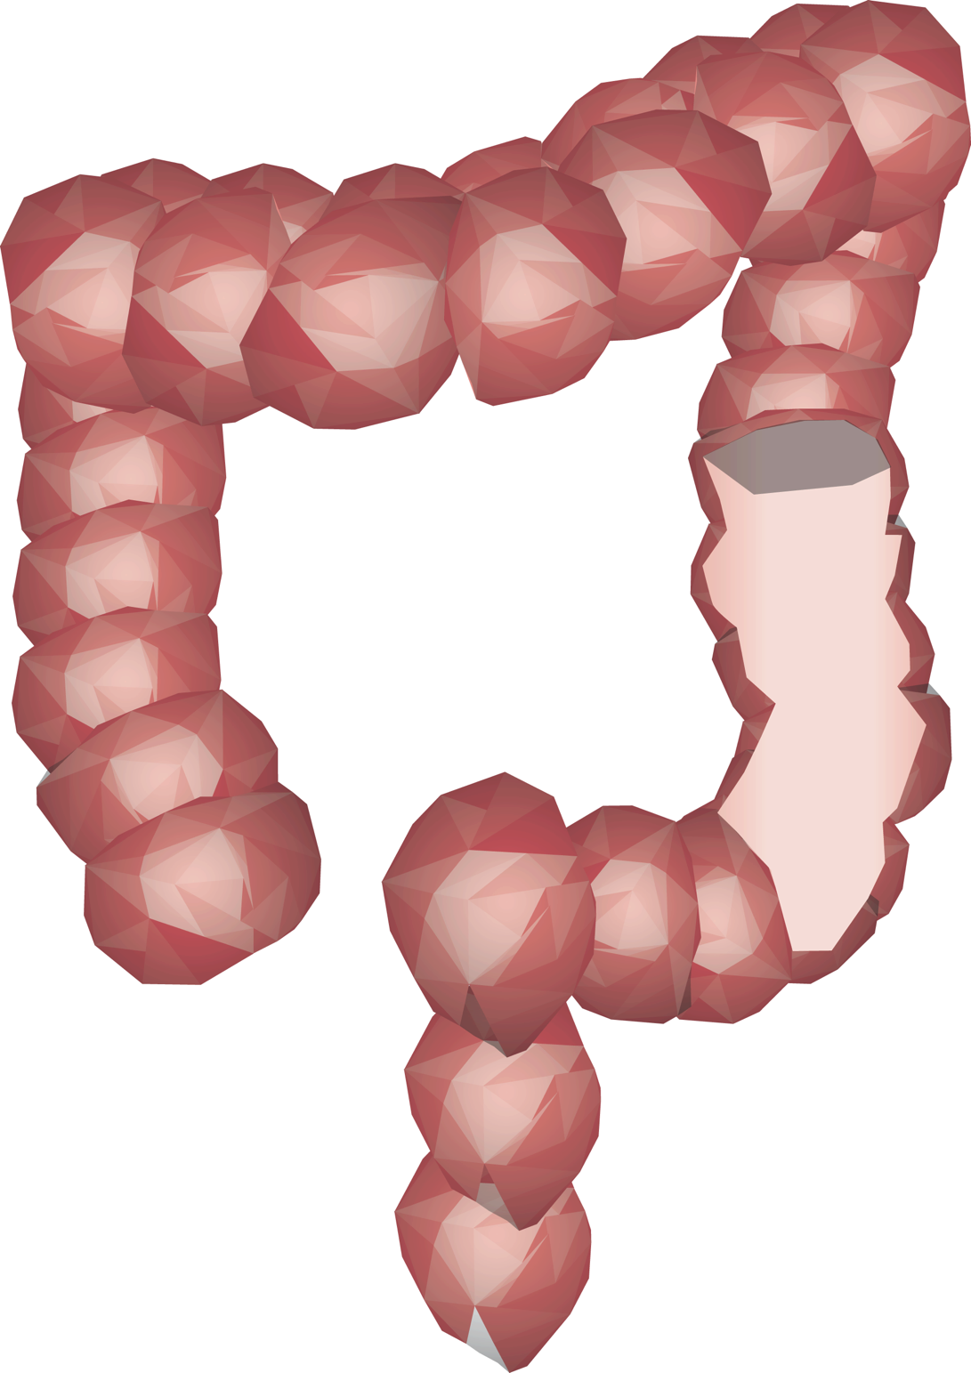







Functie microbiota: productie SCFA
Acetate
Propionate
Butyrate
Notes:
One of the most important tasks of the bacteria of the large intestine is the fermentation of complex foods which can not be digested in the small intestine.
Such as dietary fibers and resistant starches. Dietary fibers are shown to have beneficial effects on the human metabolism and a reason therefore can be be the production of SCFA
which are end products of this fermentation process.
mainly acetate, propionate and butyrate. Wheras acetate is the most abundant one.
These SCFA not only affect gut health, but they can also be taken up by other tissues like the liver where they can be metabolized.
But in part they can also reach other tissues like the fat tissue or muscle where they can also be metabolized and alter the function of this organs.

Slide 10
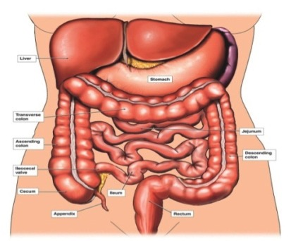
Centrale hypothese
Increasing colonic SCFA availability has beneficial effects on human substrate and energy metabolism
Question:
Where to administer? Proximal vs. Distal?
  Double blind, placebo controlled, randomized crossover studies in healthy overweight males (BMI 25 – 34.9 kg/m²)

Slide 11
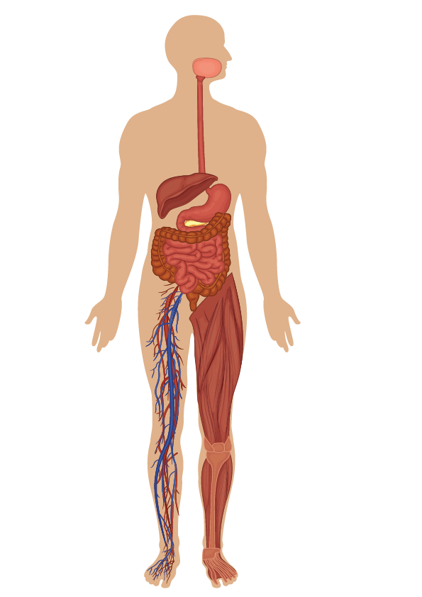

De plaats van fermentatie bepaalt de effecten op de stofwisseling
Circulating acetate ⬆
Fat oxidation ⬆
PYY ⬆
TNF-α ⬇
No significant effects
Canfora et al, Clinical Science 2016, Scientific reports 2017,
Gastroenterology, 2017

Slide 12
Fecal transplantation to improve insulin resistance
Baseline
Randomisation
6 weeks
18 weeks (e.o.s)
Allogenic fecalTx
N=13
Allogenic fecalTx
No intervention
Allogenic fecalTx
N=13
No intervention
No intervention
No intervention
No intervention
2x 24h Fecal bile acids + caloric bomb (day -2 to -1; sitostanol)
Fat biopsy and mixed Meal Test GLP1 (day 1)
Hyperinsulinemic euglycemic clamp (day 2)
Small intestinal + fecal microbiota composition + SCFA (day 3)
Autologous fecalTx
N=12
2x 24h Fecal bile acids + caloric bomb (day -2 to -1; sitostanol)
Fat biopsy and mixed Meal Test GLP1 (day 1)
Hyperinsulinemic euglycemic clamp (day 2)
Small intestinal + fecal microbiota composition + SCFA (day 3)
2x 24h Fecal bile acids + caloric bomb (day -2 to -1; sitostanol)
Fat biopsy and mixed Meal Test GLP1 (day 1)
Hyperinsulinemic euglycemic clamp (day 2)
Small intestinal + fecal microbiota composition + SCFA (day 3)

Slide 13
Overall Significant Effect 1x lean donor feces after 6 weeks on peripheral insulin sensitivity in metsyn
Kootte, manuscript in preparation

Slide 14


Highlights
Drastische verandering van microbiota dmv antibiotica heeft geen korte of lange termijn effect op de stofwisseling bij mensen met een verhoogd risico op diabetes
Feces transplantatie verbetert op korte termijn insuline gevoeligheid in ± 65% van de mensen met metabool syndroom, terwijl 35 % niet reageert
De plaats van fermentatie is een bepalende factor voor effecten op de stofwisseling: alleen distale toediening van SCFA (acetaat) heeft effecten op energie en substraatstofwisseling.
Dit kan belangrijke implicaties voor voedingsinterventies hebben
6 proefschriften, meer dan 30 publicaties zover, leads voor vervolg en valorisatie
≠

Slide 15
Project team Microbiota, energy balance and metabolism
MUMC
AMC/UMCG
Ellen Blaak, Project Leader, 0.2 fte
Gabby Hul, Project Assistant, 0.5 fte
Bert Groen, Pediatrics, Medicine,0.1 fte
Max Nieuwdorp,, Endocrinology,
Ruud Kootte, PhD student, 1 fte
Karin v Eunen 1 fte
Aycha Bleeker 1 fte
Kees Dejong, General Surgery
Ellen Blaak, Human Biology
Ad Masclee, Gastroenterology
Freddy Troost, Gastroenterology
Gijs Goossens, post-doc (0.25 fte)
Kaatje Lennaerts, post-doc (0.25 fte)
Dorien Reinders, PhD-student, 1 fte
Emanuel Canfora, PhD-student, 0.5 fte
Evelien Neis, PhD student, 1 fte
Kirsten Vanderbeek, PhD student, 0.5 fte
Ilja Arts, Epidemiology
John Penders, Epidemiology
Catherine Akwi Mbakwa,
Nicole Wyckmans, 0.5 fte
dietitian
WUR
Hauke Smidt
Erwin Zoetendal, Laboratory of Microbiology,
Javier Ramito Garcia,
Gerben Hermes, 0.5 fte

